Slide 1
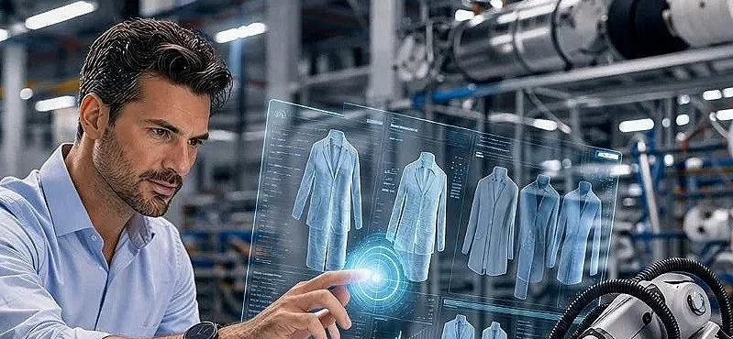
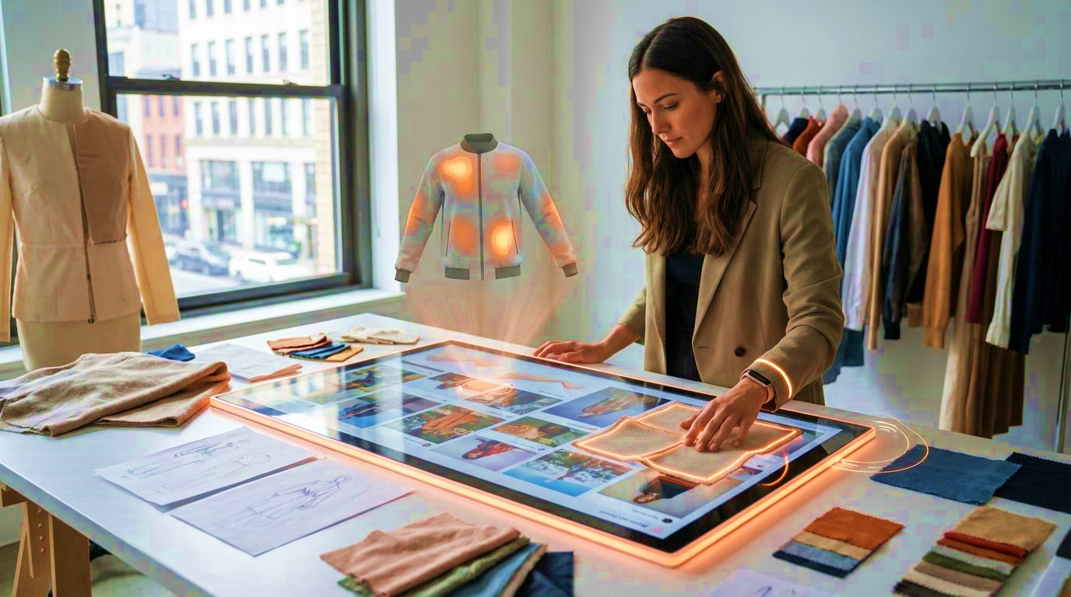
From Novice to Digital Expert: Insights of the Learning Journeys of Fashion Design Professionals in Sri Lanka
Mihirini De Silva
Department of Integrated Design
Faculty of Architecture
University of Moratuwa, Colombo, Sri Lanka.
Supervisors.
Dr. (Mrs.) Sumanthri Samarawickrama
Department of Integrated Design
Faculty of Architecture
University of Moratuwa, Sri Lanka
Dr. Sumith Gopura
Department of Textile & Apparel Engineering
Faculty of Engineering
University of Moratuwa, Sri Lanka

Slide 2
Background & Research Context
Digital transformation is reshaping the global apparel and fashion industry.
Fashion designers increasingly require digital competencies beyond traditional creative skills.
Developing countries, including Sri Lanka, face challenges aligning fashion education with industry expectations.
Limited understanding exists regarding how professionals actually develop digital capabilities
Digital transformation → Fashion industry → Education gap
Amorim et al. (2025)
Baytar (2018)
Conlon & Gallery (2024)
Lee (2022)
Papahristou & Tatsi (2024)

Slide 3
Research Problem & Gap
Existing studies mainly focus on:
  Digital tools in fashion education
  Curriculum integration
  Technology adoption
Limited empirical evidence on:
  How fashion professionals develop digital competencies
  What educational experiences shaped their digital journeys
  How industry practice influences competency development
Research gap statement:
"Understanding professional digital learning journeys is essential for developing context-responsive strategies for fashion education."
Amorim et al. (2025)
Conlon & Gallery (2024)
Papahristou & Tatsi (2024)

Slide 4
Research Aim & Objectives
Aim:
To explore how fashion design professionals in Sri Lanka develop digital competencies and identify factors influencing their digital preparedness.
Objectives:
Explore professionals' digital competency development journeys.
Identify educational and professional experiences shaping digital capabilities.
Understand industry expectations regarding digital competencies.
Provide recommendations for strengthening fashion education.

Slide 5
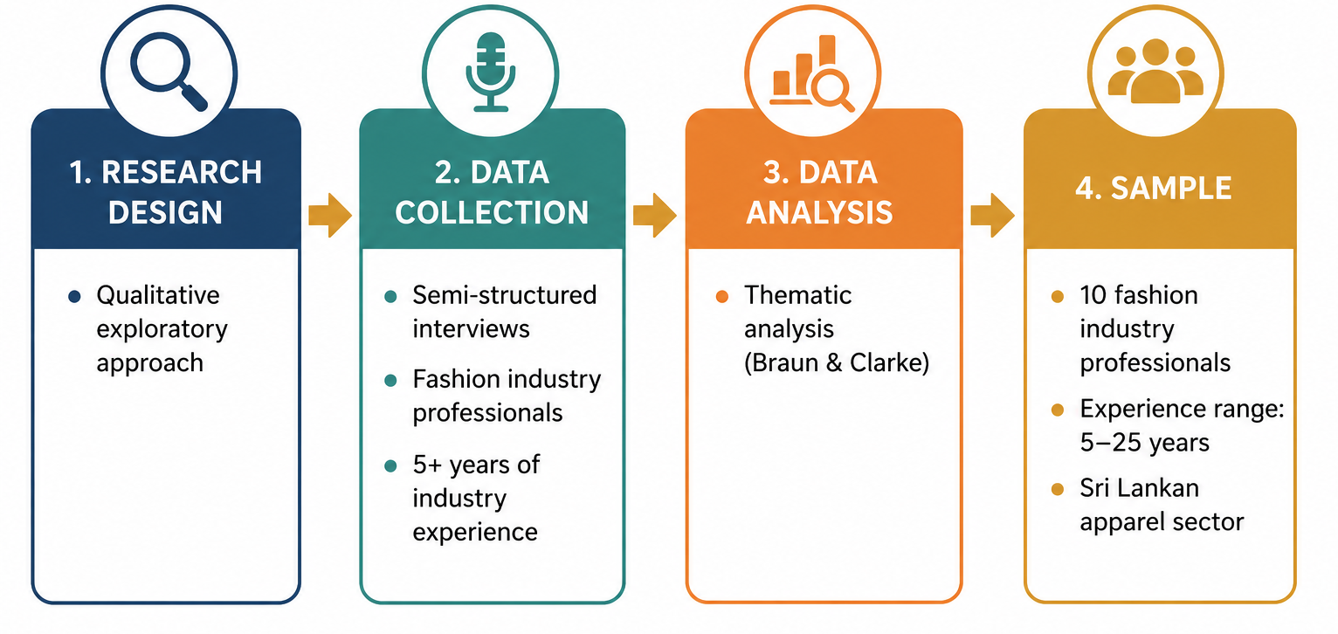
Research Methodology
Braun & Clarke (2022)
Creswell & Poth (2018)

Slide 6
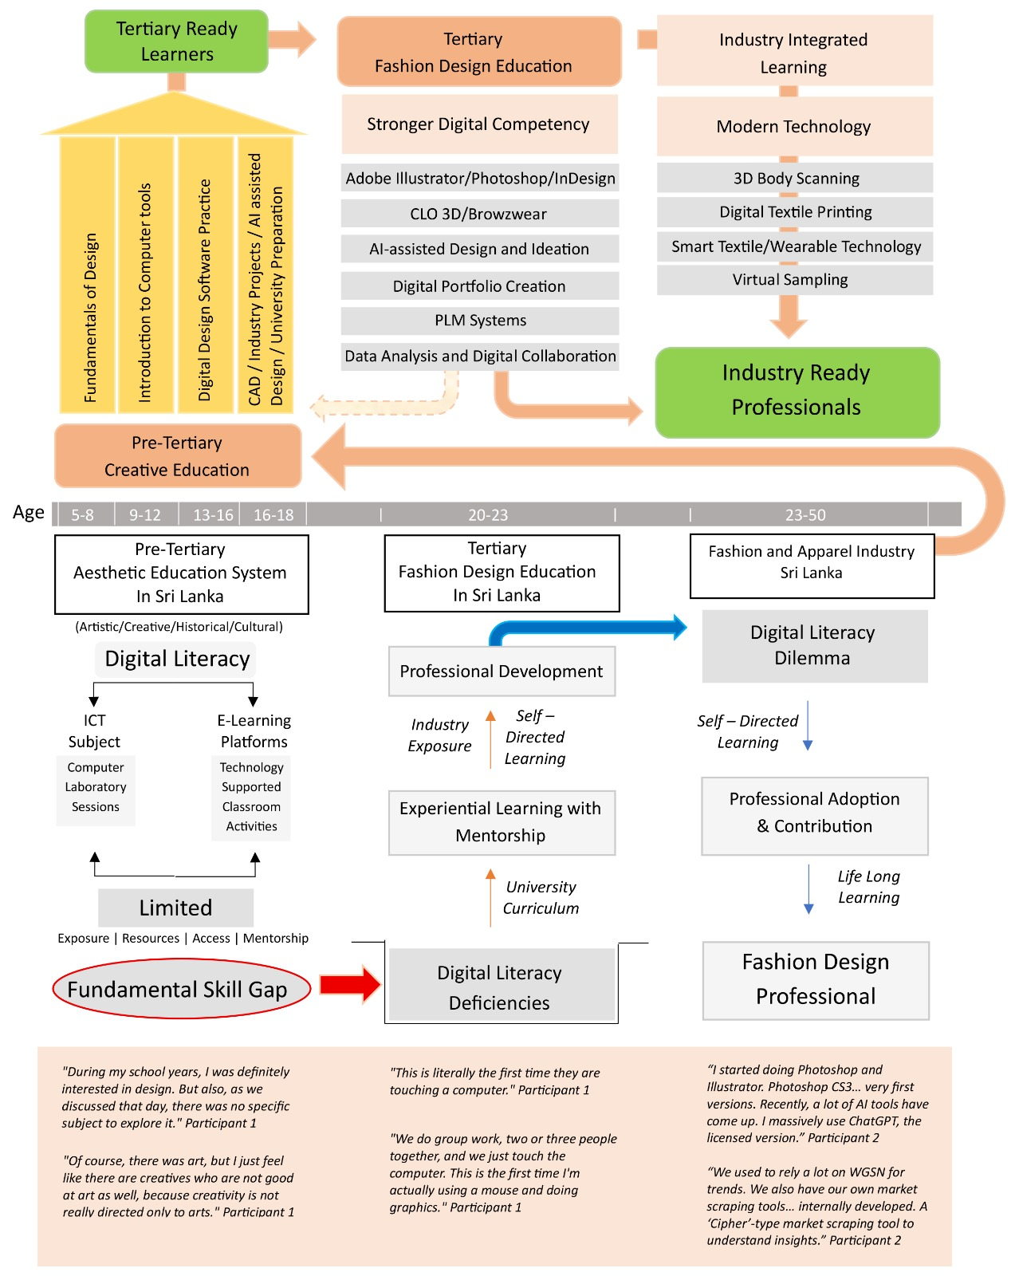
Professional Digital Competency Development Journey
Challenging Education-to-Industry Transition
Digital Competencies Through Practice
Limited Early Exposure
Educational Preparedness
& Gaps
Self-directed and Experiential Learning

Slide 7
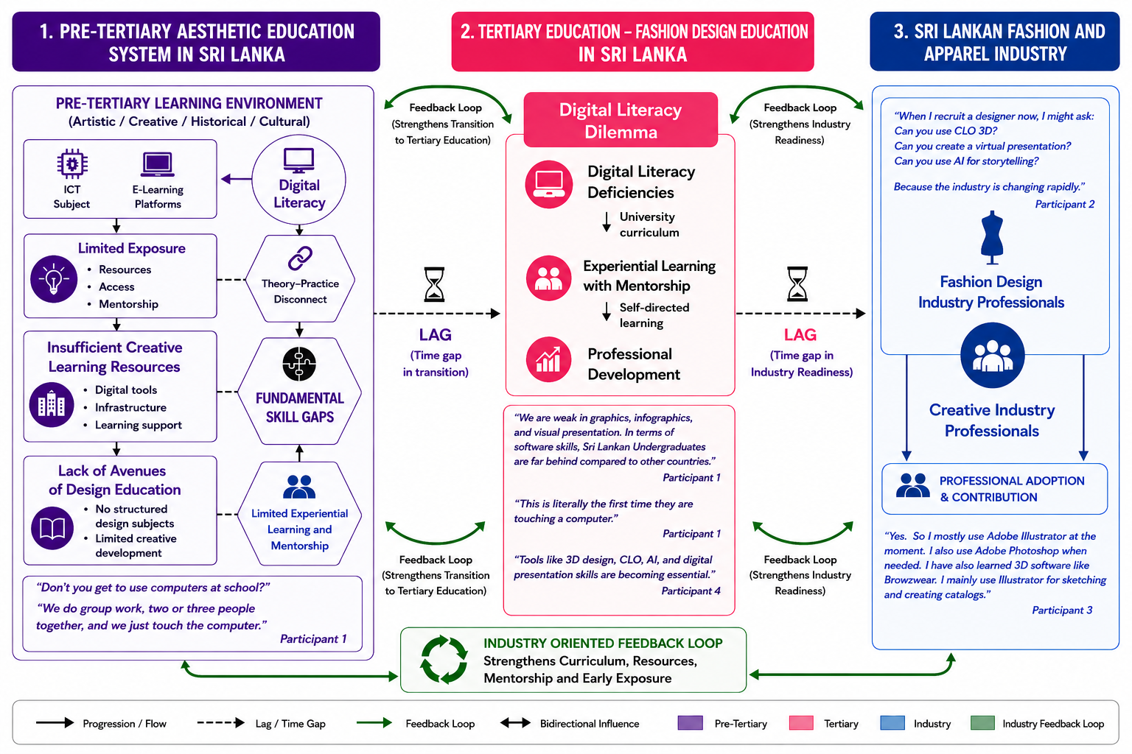
Industry-Oriented Digital Competency Development Framework
I-ODCD Framework
Key Contributions
Digital competency develops across three interconnected stages.
Industry experience strengthens digital capability.
Continuous self-directed learning bridges educational gaps.
Industry feedback informs curriculum improvement.
Collaboration between education and industry supports lifelong digital competency development.

Slide 8
Implications & Recommendations
For Fashion Education:
Introduce digital literacy earlier.
Integrate industry-relevant tools.
Strengthen academia–industry
collaboration.
For Industry:
Support graduate transition
through mentoring.
Provide continuous learning
opportunities.
For Future Research:
Validate framework across wider contexts.

Slide 9
Conclusion
Digital competency development is a continuous learning journey.
Professional practice plays a major role in building digital capabilities.
Fashion education must evolve through stronger industry alignment.

Slide 10
Thank you

